Slide 1
BLOCKCHAIN
Shubhada Babhulgaonkar
Smriti Bariwal
Sulagna Pramanick
B2019047
B2019048
B2019054

Slide 2
What is Blockchain?
A Database
A list of records / transactions, like a ledger, that keeps growing as more entries are added;
which is distributed
Copies of the entire database are stored on multiple computers on a network, syncing within minutes / seconds;
Adjustably Transparent
Records stored in the database may be made visible to relevant stakeholders without risk of alteration;
Highly Secure
Malicious actors (hackers) can no longer just attack one computer and change any records;
and Immutable
The mathematical algorithms make it impossible to change / delete any data once recorded and accepted

Slide 3
Blockchain Benefits
Increasing transparency
Improving profitability and quality
Reinventing products and processes
Automation using smart contracts / algorithms
Traceability of all historical transactions
Speed and efficiency of transactions by eliminating intermediaries
Enhanced security by encryption of data at the stage of dissemination
Prevents tampering as any tampering may leave behind trail
Transparent and predefined rules which facilitates creation of new products / processes through a decentralized model
Tokenization / Digital Assets which are physical objects with a unique digital representation that enable digital ownership, management and transfer
Distributed ledger
Provides a comprehensive picture: all stakeholders see the same information to which they have access
Availability of multiple copies of the shared data

Slide 4
Problem Statement
Indian government wants to implement blockchain for securing the transactions by adding pan card numbers in the transaction details. Implementing this using python.

Slide 5
Steps Involved
Peer to peer network
Consensus Protocol
1
2
3
4
Building a blockchain
Bitcoin Mining

Slide 6
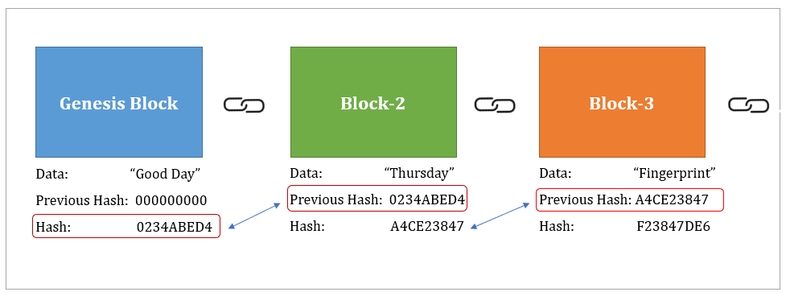
Building a Blockchain
Each block of blockchain contains following information
Block number
Timestamp
Nonce
Message/Data
Previous hash
Current hash
For 1st block: previous hash = 0
Blockchain is a decentralized ledger tracking of one or more digital assets on a peer-to-peer network. In a decentralized peer-to-peer network all the computers are connected in some way and each maintains a complete copy of the ledger and compares it to other devices to ensure the data is accurate. This is unlike a bank, where transactions are stored privately and are managed only by the bank.

Slide 7
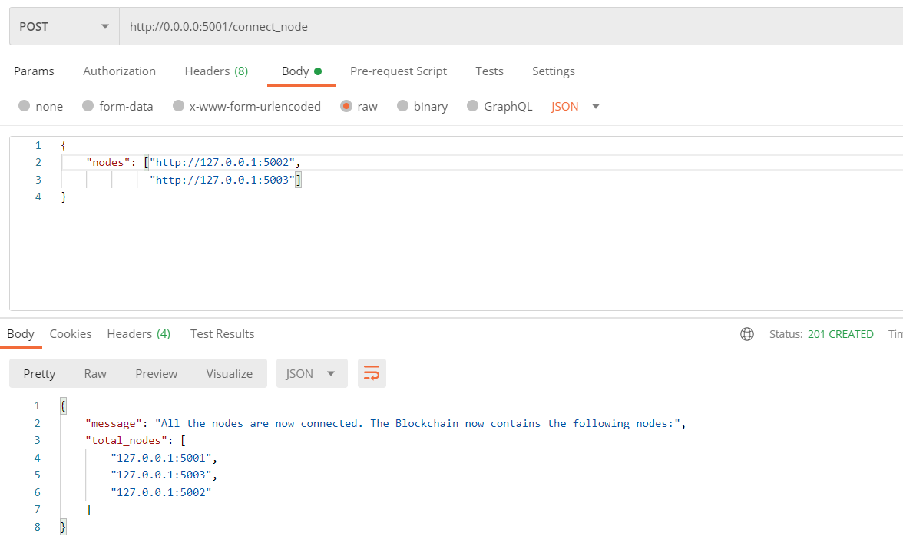
Adding & Connecting Nodes
Considered three blockchain nodes connected through ports 5001, 5002, 5003
Connected these three nodes to each other by using connect_node function
Once the nodes get connected to each other successfully the success response will be displayed.

Slide 8
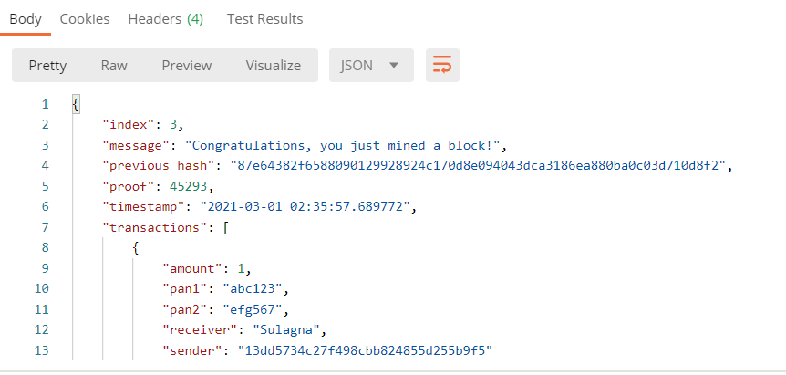
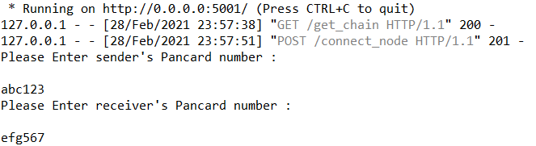
Mining of block
After all nodes get connected through peer to per network a block is mined by taking previous hash node address, sender & receiver details (includes their PAN number)

Slide 9
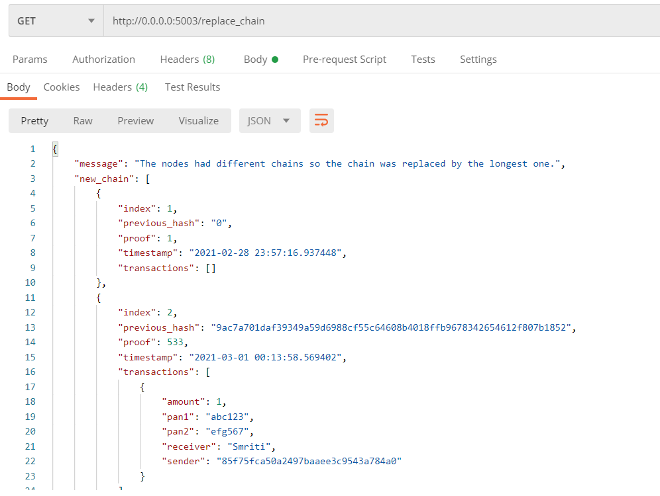
Replace chain
After mining when the transaction is verified, it is added to the block
Then lengths of nodes in peer to peer network are compared & the chain with maximum length is selected
If length > max length ; new block added

Slide 10
THANK
YOU

